Slide 1
DATA mining REVIEW

Slide 2
References
Slides adapted from
Chapter 4 of Python Machine learning by Sebastian

Slide 3
Predictive models
Classification and class probability estimation
Regression
Clustering

Slide 4
Classification and class probability estimation
Goal
Predict the class, an individual from a population belongs to. Usually there are few mutually exclusive classes.
Example
Among all the patients treated with chemotherapy, Which are likely to survive for 5 years?
Two classes: “Will survive” and “ Will not survive”
Procedure: Learn from historical data with known features and use it to predict future data with unknown class labels

Slide 5
Regression
Problem/Goal
For each individual, estimate/predict the numerical value of some variable for that individual.
Example
“How much will a given customer use the service”.
The variable of the individual is service usage.

Slide 6
Classification Versus Regression
Classification predicts if something will happen or not.
Classification assigns a class.
Regression predicts how much something will happen.
Regression estimates an amount of an event.

Slide 7
Clustering
Total population
(No class labels)
Individuals within the group
are more similar to each other
compared to the individuals
in other groups.
Group1 Group2 Group3 Group4

Slide 8
More examples of clustering
Social network analysis
Detect communities.
Image Processing
Group different pixels into groups for object recognition.
Medical imaging
Cluster different pixels of Scans to differentiate different types of blood, tissues etc.
Crime analysis
Cluster analysis can be used to identify areas where there are greater incidences of particular types of crime.

Slide 9

Supervised
Unsupervised
Smiley and Sad
face population
(known class labels)
(unknown class labels)
Learn from known data
Classification algorithm
Model
Apply the model
New population
prediction

Slide 10
Prediction: Problem
A customer nearing the end of a phone contract
Minutes usage / month | Number of Late payments | Number of phone lines | Switched service ?
300 | 2 | 3 | ?
We want to predict if this person will switch or not ?
(The Problem of churn)

Slide 11
Step 1: Prepare historical data for many individuals
Attributes/Features
Target Attribute
Minutes usage / month | Number of Late payments | Number of phone lines | Switched service ?
110 | 2 | 1 | YES
50 | 0 | 3 | NO
.. | .. | .. | ..
100 | 6 | 1 | YES
Training Data Set
Collect and prepare data in a particular format (usually
Tabular format ).
Make sure there are no missing values.
Make sure there is enough data available.

Slide 12
Step 1: Prepare historical data for many individuals
Attributes/Features
Target Attribute
Minutes usage / month | Number of Late payments | Number of phone lines | Switched service ?
110 | 2 | 1 | YES
50 | 0 | 3 | NO
.. | .. | .. | ..
100 | 6 | 1 | YES
Training Data Set
Each row is an instance or example
Feature vector <100, 6 , 1, YES>.
Attribute can be numeric or categorical.

Slide 13
Step 2: build a model that describes the historical data
Minutes usage / month | Number of Late payments | Number of phone lines | Switched service ?
110 | 2 | 1 | YES
50 | 0 | 3 | NO
.. | .. | .. | ..
100 | 6 | 1 | YES
Training Data Set
Data mining/ Exploration
Model

Slide 14
Step 3: Prediction using the model
Minutes usage / month | Number of Late payments | Number of phone lines | Switched service ?
300 | 2 | 3 | ?
to be predicted?
Model
Will switch
Probability: 0.88

Slide 15
Predictive models
Tree-like
Decision Trees
Random Forest
Boosted Trees
Probabilistic methods
Naïve Bayes
Logistic Regression
Kernel methods
Support Vector Machines (SVM)
Neural Networks (Deep Learning)

Slide 16
Tree models and Ensemble Tree Models
Decision Trees (weak Learner)
Random Forest (Collection of weak learners)
Boosting: Boosted Trees (Collection of weak learners)

Slide 17
Decision Trees
categorical
categorical
continuous
class
Splitting Attributes
Refund
Yes
No
NO
MarSt
Single, Divorced
Married
TaxInc
NO
< 80K
> 80K
NO
YES
Training Data
Model: Decision Tree
Tan et al, Intro to data mining

Slide 18
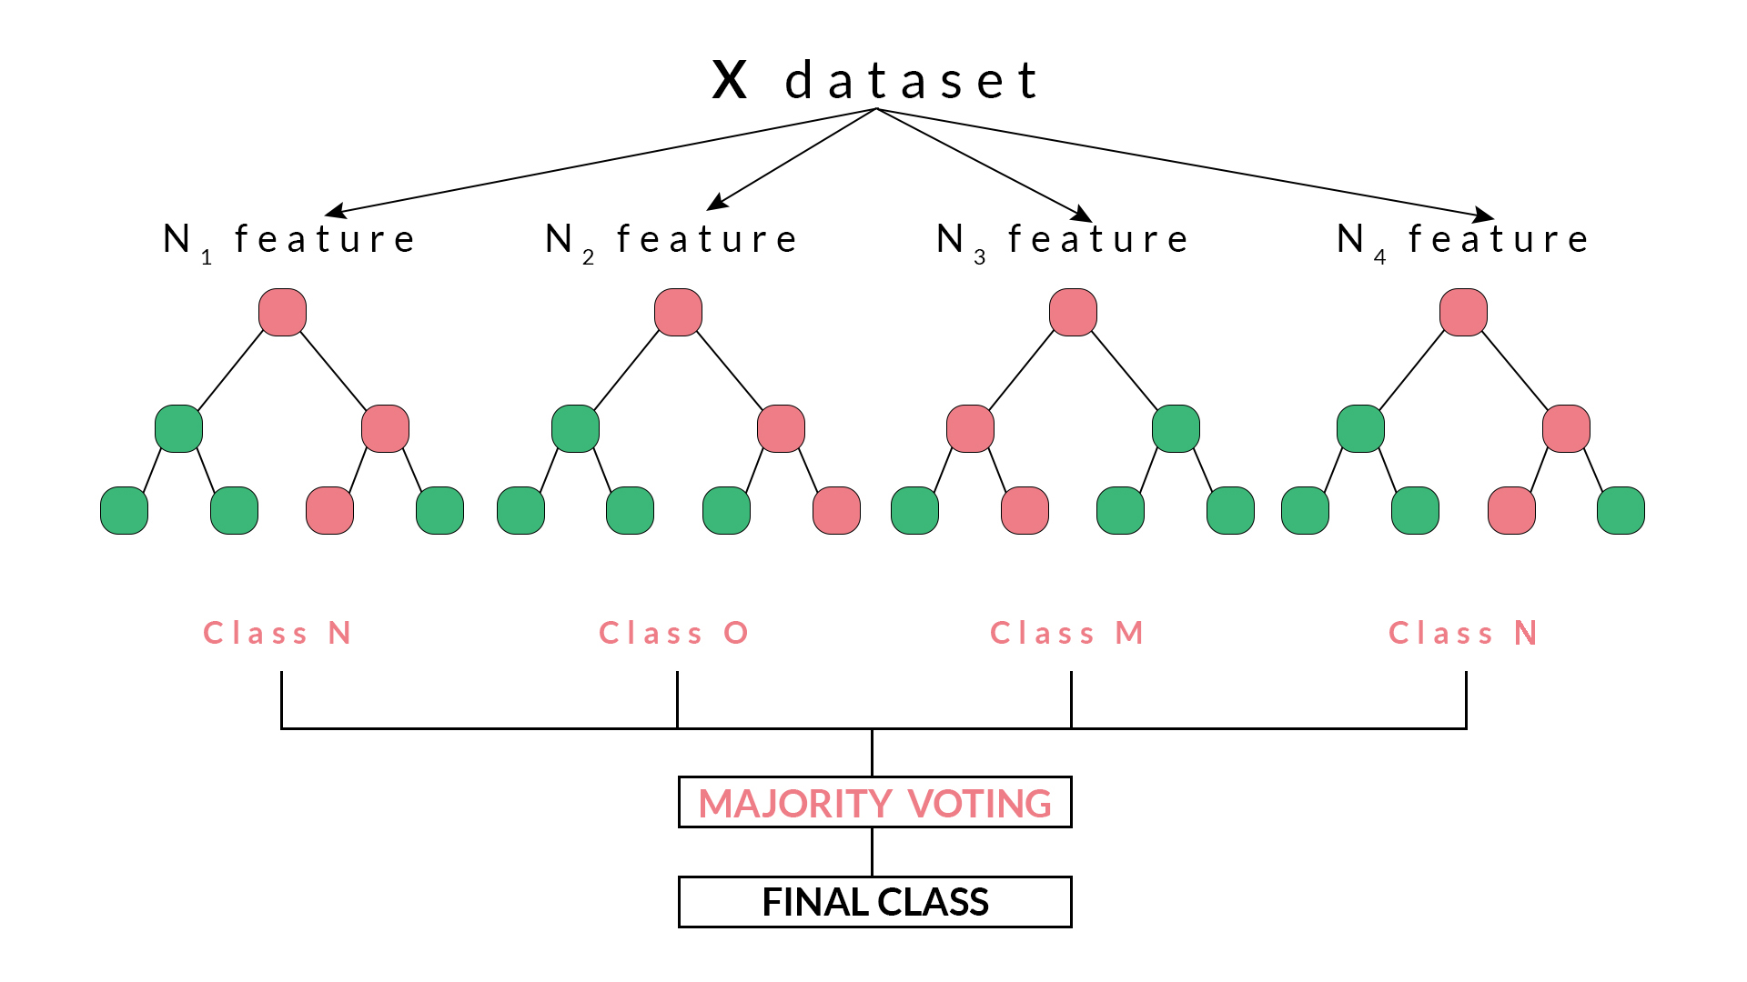
Random Forest
Features chosen independently for each tree
https://blog.quantinsti.com/random-forest-algorithm-in-python/

Slide 19
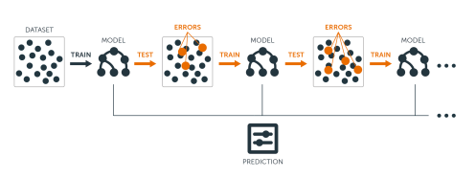
Boosted Trees
Individual Trees built sequentially and added

Slide 20
Probabilistic models
Naive Bayes
Logistic regression

Slide 21
Probabilistic models
N data points X₁, X₂, …, X_{N} (p attributes) with known class labels y₁, y₂, y₃, .., y_{n}
Probability that each the data point X_{i} is classified as class y_{i} is denoted by p(Class_{i} = y_{i})
Use some functional form for this probability
Optimize the overall probability of all X_{i} s to be correctly classified

Slide 22
Kernel Methods
Support vector machines
Kernel
linearly
separable data in higher
dimensions
Then find the linear optimal
Hyperplane
Not linearly
separable data with
two classes

Slide 23
Issues: Validating or evaluating PA models
There can be multiple models to solve the same problem.
Predictive accuracy.
How well the model can predict ?
Speed and scalability.
Time needed to build the model.
Time used by the model in predicting.
Interpretability.
Can you understand the rules of the model ?

Slide 24
Traditional model vs Deep Learning
Traditional
Models
Deep
Learning
Deep
Learning
Features are
learned automatically
https://www.learnopencv.com/image-recognition-and-object-detection-part1/

Slide 25
Deep Learning needs large amount of data

Slide 26
Preprocessing
Read the data (features and class labels) from a file and store in a data structure
Pandas Data Frame or Numpy matrix (can store only numerics) in Python
Data Frame in R
User can choose to remove any unwanted features or samples (primarily manual at this point).

Slide 27
Dealing with missing values
Remove rows with missing values in features.
You may also want to remove features (columns) that have too many missing value in many samples.
Imputation of missing values
Different interpolation techniques to estimate the missing values from the other training samples in our dataset.

Slide 28
Dealing with categorical features
Categorical features should be converted to numerical values.
Categorical data: nominal and ordinal features.
Ordinal features: can be sorted or ordered.
For example, T-shirt size: XL > L > M
Assign XL = 3, L = 2, and M = 1
Nominal features: can’t be sorted.
For example: T-shirt color (Red, Green, Blue)
One-hot encoding: Red -> [1,0,0], Green -> [0,1,0], Blue = [0, 0, 1]
This will require additional features to be added.

Slide 29
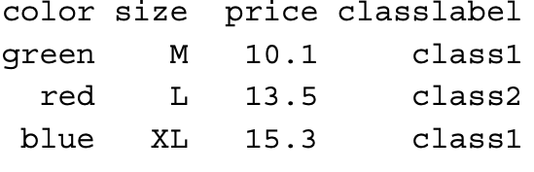
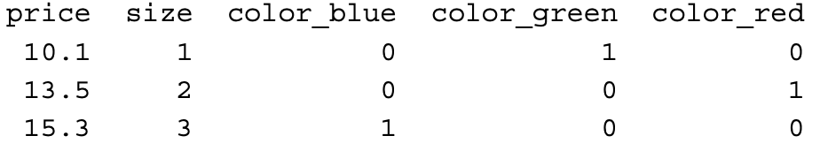
Dealing with categorical features
Old
data
New
data

Slide 30
Split data and feature scaling
Split the data into training (80%) and testing (20%)
Make sure 80% of each class go to training
Feature scaling: bring features to the same scale.
Note this step should be done after splitting the data into training and testing sets
First, scale the training set.
Use the parameters used in scaling training set to scale the testing set.
Don’t scale the testing set independently from training set.

Slide 31
Feature Scaling
Feature scaling: Process of bringing all the features to the same scale.
Why ?: So that model can “weigh” and “interpret” the features in a non bias way.
Normalization: scale between 0 and 1 (min-max) scaler
Standardization: scale so that values have mean = 0 and standard deviation = 1

Slide 32
Feature Scaling
The following table illustrates the difference between the two commonly used feature scaling techniques, standardization and normalization on a simple sample dataset consisting of numbers 0 to 5:

Slide 33
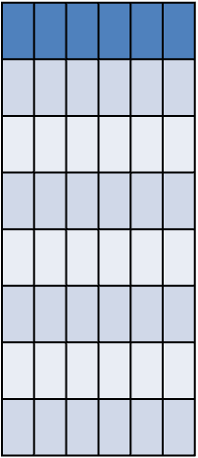
Feature scaling
Train
Data
features
Features
Use
Same μ and σ
From training feature i
To scale feature i in test set
Test
Data
features

Slide 34
CLASS imbalance
If there is class imbalance, make the training set balanced
Up sampling.
Down sampling .
SMOTE (Synthetic Minority Oversampling Technique).
Generative Adversarial Networks (GANs) – Deep Learning method.
Train the balanced training set.
Keep the testing set imbalanced.
This should represent an accurate class composition in the future test data.

Slide 35
Training MODEL
1. Identify the parameters in the model
2. Define a parameter space for the identified parameters
Hyper-parameter or parameter optimization: Explore the the parameter space using some method (e.g : Grid Search)
(Resampling: to minimize overfitting, repetition gives u an idea of future predictions e.g: k-fold cross validation)
repeated
Train data
Fit Model
Resample
data
predict
Validation data
4. Collect performance across candidates from parameter space
Here you can see how the
performance change when you
vary the value of the parameter
5. Choose the best set of parameters based on a metric
Example metric
Accuracy for Classification
6. Build the model on the whole data set using the selected parameter

Slide 36
Parameter (Hyper-parameter) optimization
Grid search cross validation
Try every possible candidate from parameter space
Ideal for small space
Random search
Try a random set of possible candidates from parameter space
Ideal for small space
Bayesian optimization
Automated and “wise” choice of possible candidates from parameter space

Slide 37
SAMpling (validation) methods
K-fold Cross Validation
Leave one out cross-validation
Boot Strap Cross Validation

Slide 38
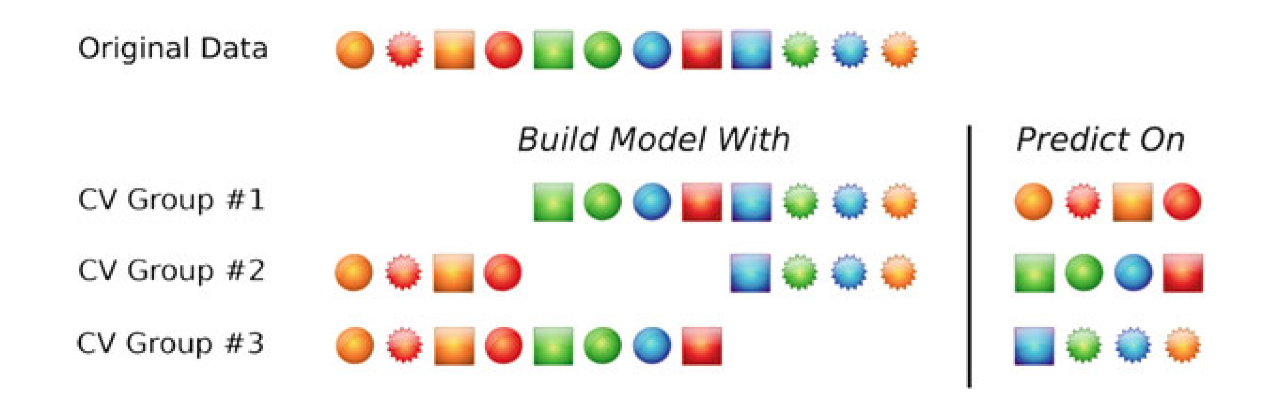
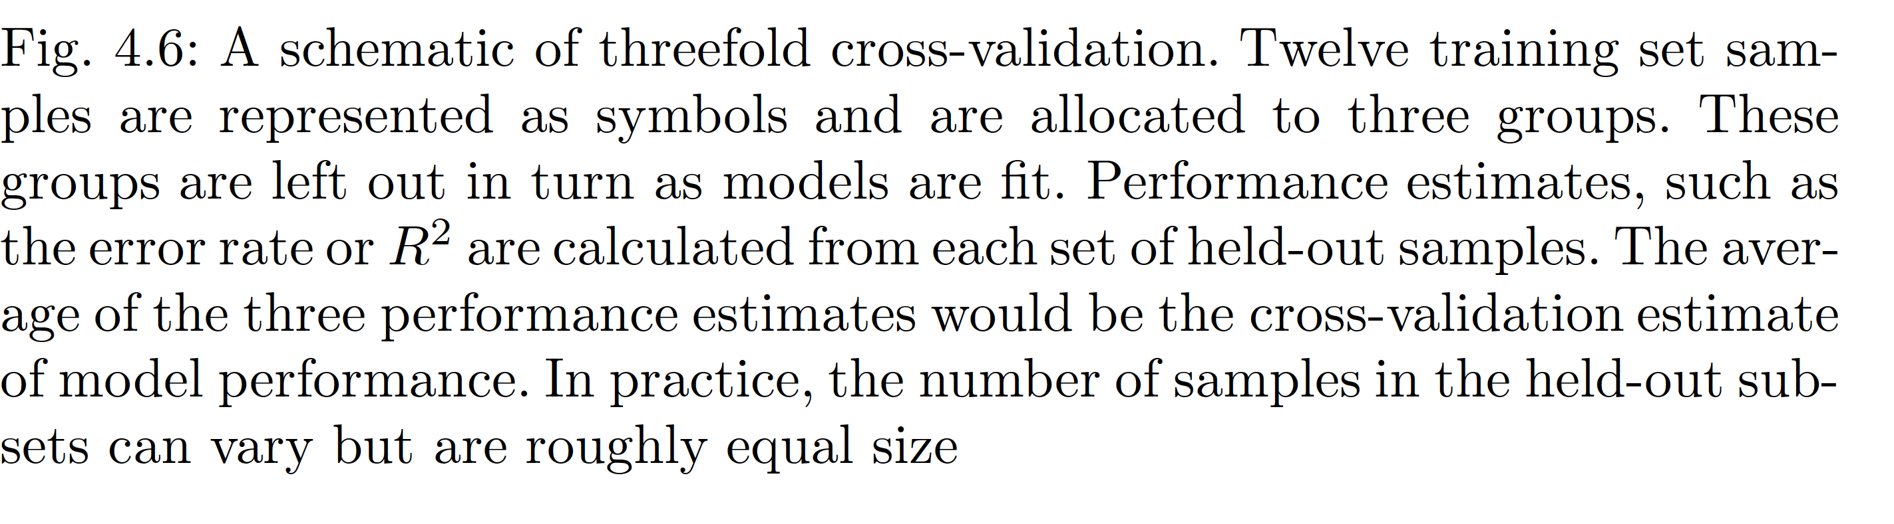
K-fold (below is K=3 fold)

Slide 39
Leave-one-out cross-validation (LOOCV)

Slide 40
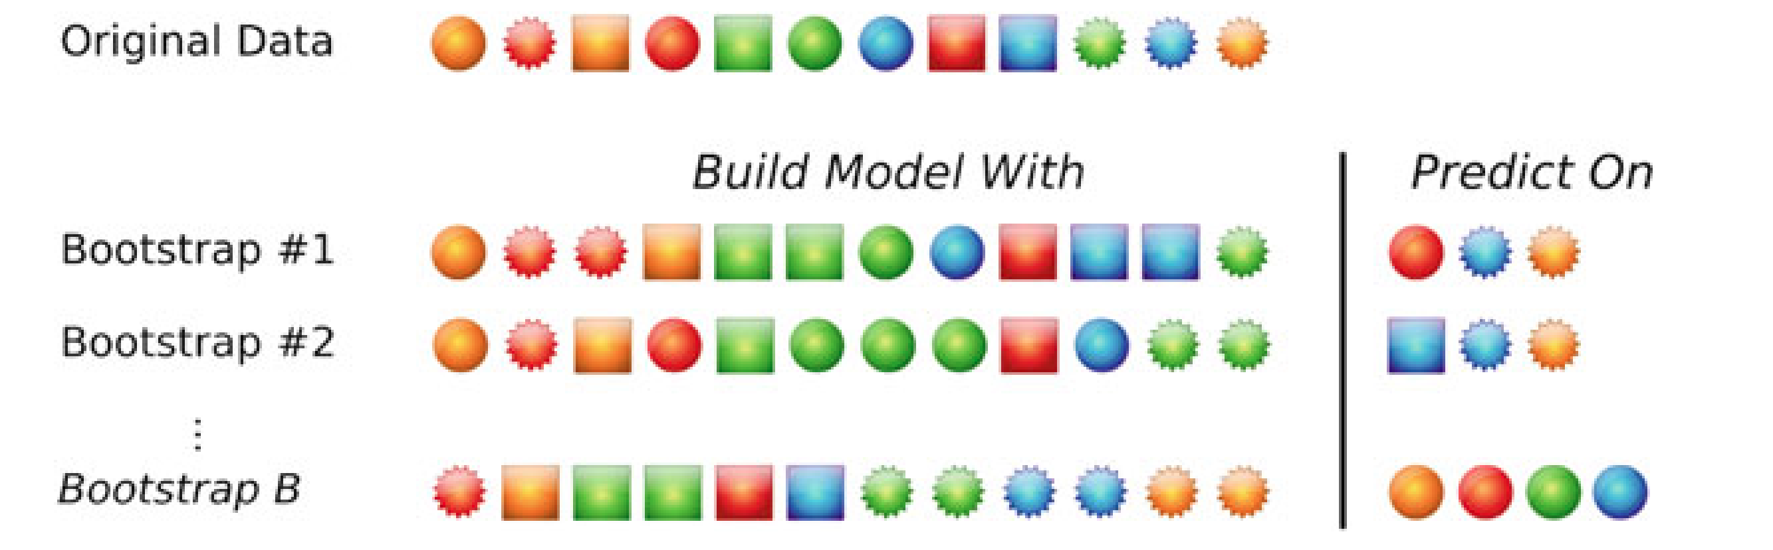
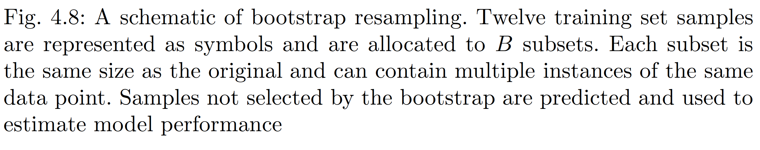
Boot Strap CROSS VALIDATION

Slide 41
Pros cons of sampling techniques
LOOCV
All training samples overlap too much
Less bias in training (less training error)
High variance in testing errors (not consistent with different test data)
K-fold
Training samples overlap less than LOOCV
bias-variance balance
Repeated K-fold may perform better than k-fold
Bootstrap
Less variance (consistent with different test data)
May be high bias (higher training error)
But depends on the data.

Slide 42
Training and Test Performance
Bias is the difference between the average prediction of our model and the correct value which we are trying to predict.
Variance is the variability of model prediction for a given data point or a value which tells us spread of our data.
under fitting ->
need to make model
more complex
Overfitting ->
need to make model
less complex

